Slide 1

CLASSIFICATION OF SIGNIFICANT WATER RESOURCES AND DETERMINATION OF RESOURCE QUALITY OBJECTIVES FOR WATER RESOURCES IN THE USUTU TO MHLATHUZE CATCHMENTS (WP11387)
Project Steering Committee 4, 13 April 2023

Slide 2
8.4 Economics
Riekie Cloete/William Mullins

Slide 3
ECONOMIC APPROACH – Data Sources
Water use and hectare data based on past and ongoing studies of DWS, reports
Enterprise budgets from Department of Agriculture and
crop data (Price/Ton) - The Abstract of Agricultural Statistics of the Department of Agriculture, Land Reform and Rural Development 2021/2022
Data sourced for the various mills from South African Forestry, Mondi and SA canegrowers

Slide 4
ECONOMIC APPROACH – Data Sources (cont.)
Mining and Heavy Industries - Conningarth Industrial Database (CID) allocated and refined for the IUAs
Eco-tourism - Tourism KwaZulu-Natal Statistics Reports, own calculations as well as the CID
Economic Tools:
The KwaZulu-Natal SAM developed by Conningarth Economists
Modelling systems – Conningarth Economists

Slide 5
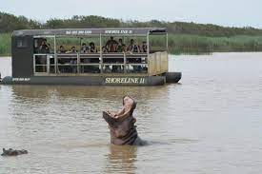
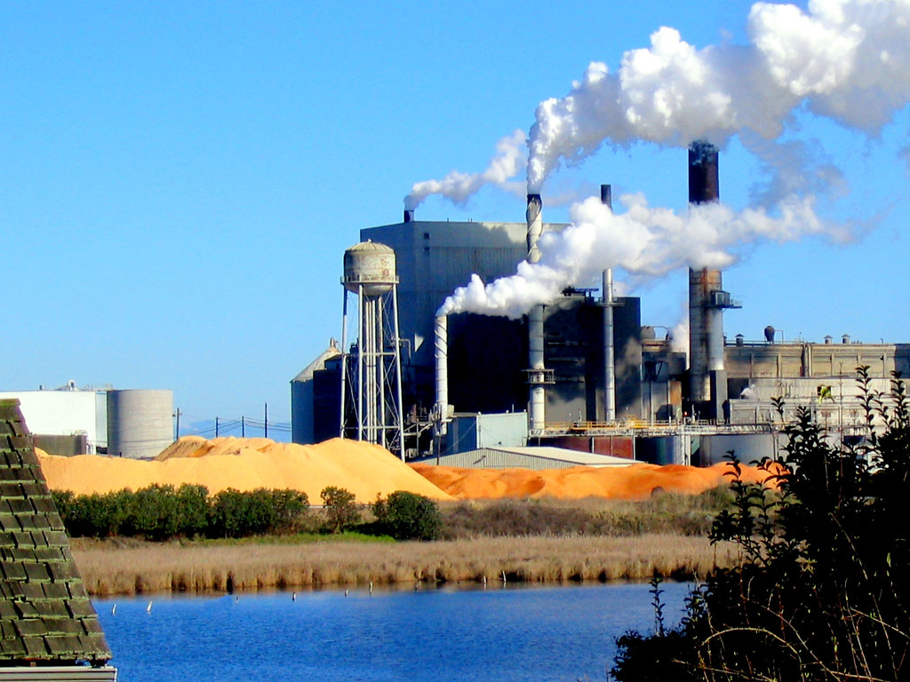
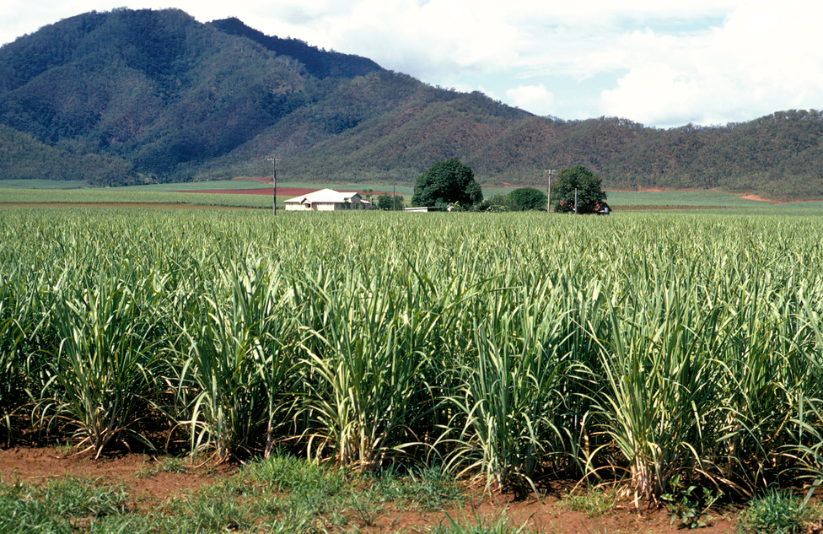
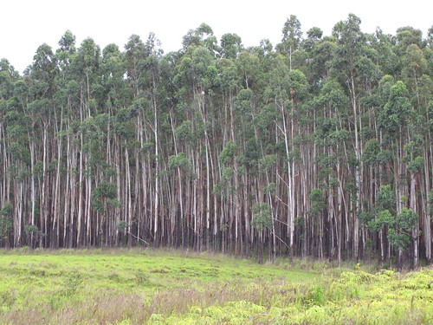
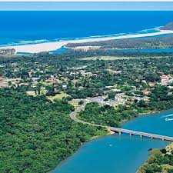
ECONOMIC SECTORS
Primary
Agriculture and Forestry
Secondary Manufacturing
Tertiary
Eco-Tourism
Maize, Soya beans, Summer and Winter Veggies,
Potatoes, Cotton
Pineapples, Bananas, Avo’s, Citrus
Irrigation and Dryland Sugar Cane
Nature Reserves
Lakes
Sugar,
Saw,
Paper
Mills
Hillside Aluminium
Pine
Gum
Wattle

Slide 6
Economic Indicators
Gross Domestic Product (GDP)
The impact on GDP reflects the magnitude of the values added to the regional and wider economy from activities using the water. Value added is made up of three elements, namely:
  Remuneration of employees (payments to households),
  Gross operating surplus (which includes profit and depreciation), and
  Net indirect taxes (taxes and subsidies).
Employment
Household Income

Slide 7
Economic Modelling Approach
Enterprise budgets for each irrigation crop and commercial plantation were developed for the study area.
Financial Turnovers per Industry were estimated.

Slide 8
Enterprise Budget structure (Irrigation)
Gross Income
(Price x Quantity)
Variable Cost
Marketing Cost, Pre-Harvest Cost, Harvest Cost
Interest on Working Capital
Gross Income minus Variable Cost minus Interest on Working Capital
Gross Margin
Depreciation, Labour, Insurance, Repair and Maintenance, Administrative Cost, Fuel and Electricity, Sundry Items
Fixed Costs
Net Farm Income
Gross Margin minus Fixed Costs
Net Income
Net Farm Income minus Yield on Land Value, Yield on Capital, Management Fees

Slide 9
Used for Baseline and Scenario Modelling
Water Impact Model – Budget Driven
Inputs:
Irrigation Agriculture
Main Drivers: (Water Volume; Hectares)
Specific Enterprise Budgets (Income and Costs)
Costs distributed to economic sectors taken up in the economy (Agriculture, Mining, Manufacturing, Electricity, Water, Trade and Accommodation, Transport and Communication, Financial and Business Services)
Economic
Water
Modelling
Multipliers derived from Social Accounting Matrix
Direct, Indirect and Induced impacts:
GDP
Employment
Household Income
Output: Results

Slide 10
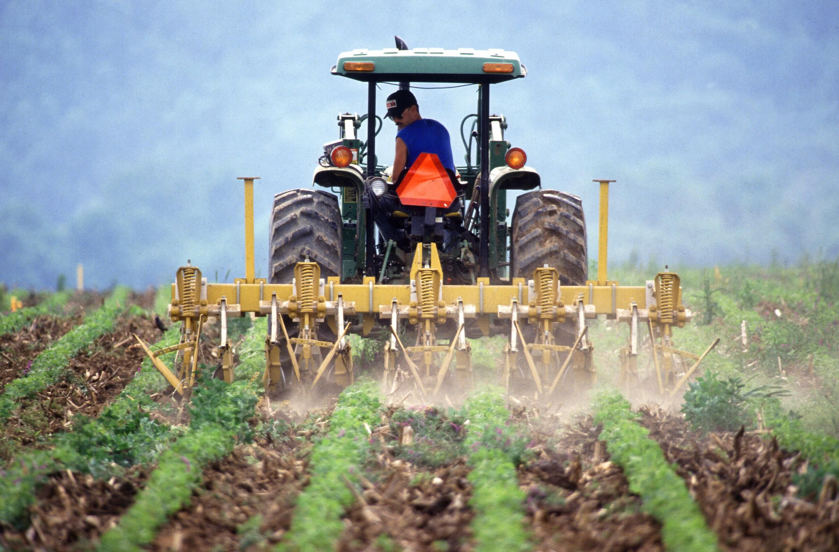
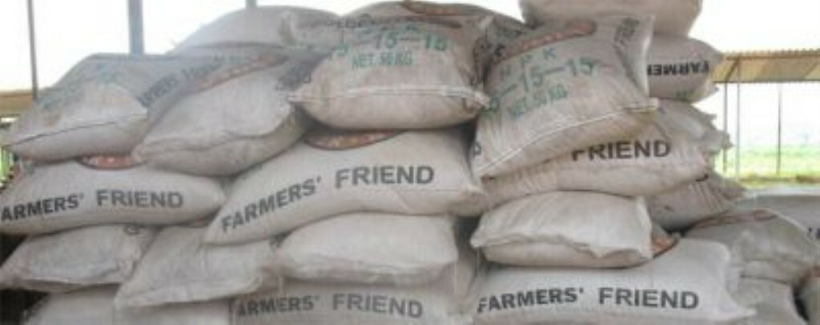

Economic Impacts
Direct + Indirect+ Induced = Total
Direct:
Production Output
Indirect:
Industries providing production Inputs
Induced:
Services procured from income earned from direct and indirect production activities
This Photo by Unknown Author is licensed under CC BY

Slide 11

BASELINE SOCIO-ECONOMIC PROFILE
Total GDP (Rand Millions)

Slide 12

BASELINE SOCIO-ECONOMIC PROFILE
Total Employment (Numbers)

Slide 13

BASELINE SOCIO-ECONOMIC PROFILE
Total Household Income (Rand Millions)

Slide 14
RIVER SCENARIOS
Socio-Economic Consequences
Impact of Irrigation Agriculture Economic Scenarios

Slide 15
ESTUARY SCENARIOS
Socio-Economic Consequences
Impact of Commercial Forestry and
Irrigation Agriculture Economic Scenarios

Slide 16

Closing Remarks
Although not a significant economic catchment, it provides for rural and urban communities, jobs and household income and contribution to the national economy
There weren’t any significant economic changes from the results of the scenario analysis

